Slide 2
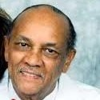
Dr. Charles A. Champion

Slide 3
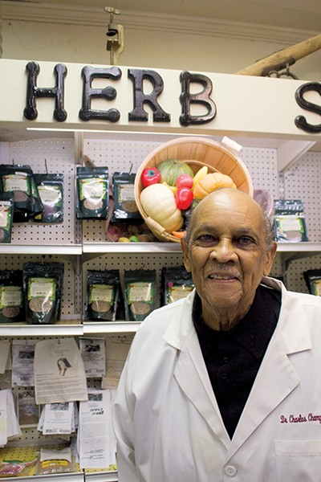
Dr. Charles A. Champion, better known as the herbal pharmacist, was born in Memphis, Tennessee in 1930 and raised in Greenfield, Tennessee. He is the owner of Champion’s Pharmacy and Herb Store on Elvis Presley Boulevard in Memphis, Tennessee.

Slide 4
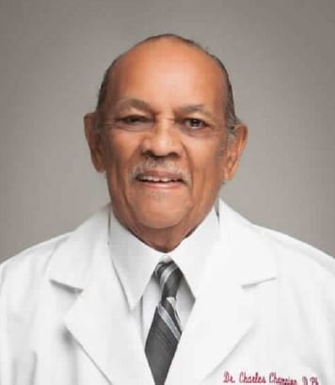
Dr. Champion graduated from Xavier University College of Pharmacy in New Orleans, Louisiana. He spent two years in Germany as a pharmacist for the United States Army. He then returned to Memphis to work in the pharmacy at John Gaston Hospital, better known today as Regional One Medical Center. He was the first African American Pharmacist to work in a Memphis hospital.

Slide 5
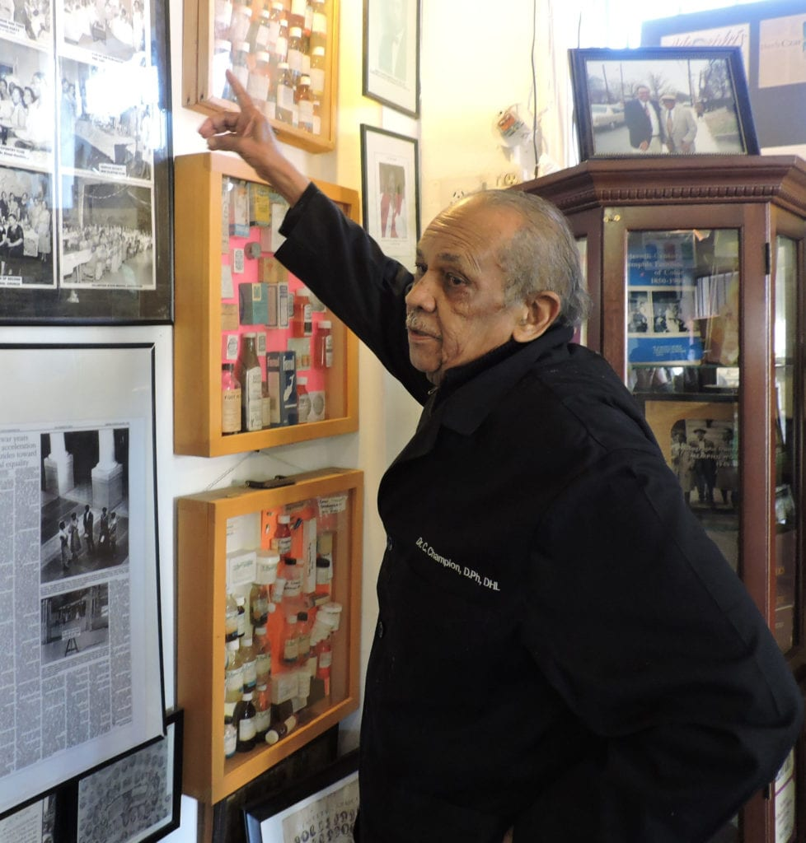
Later, Dr. Champion took a job at Katz Drug Store. He became the first African-American hired by a drug store chain in the city of Memphis. In 1981, Dr. Champion opened his own pharmacy that is still open today!

Slide 6
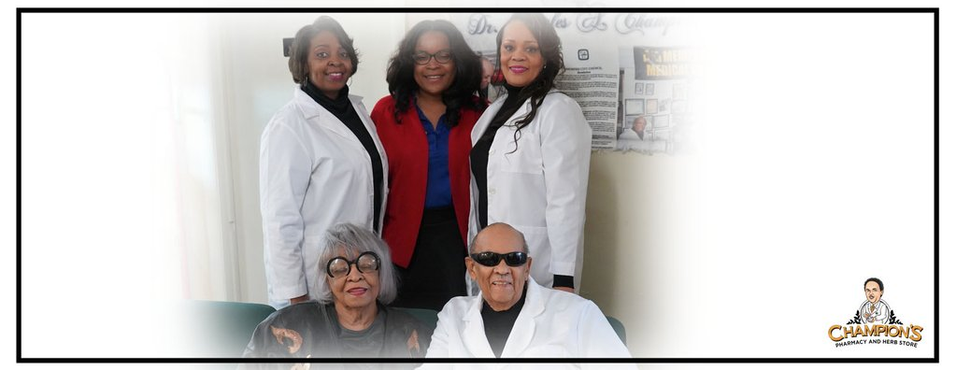
Dr. Champion married the former Carolyn Bailey in 1958. Carolyn Bailey Champion is the daughter of Walter and Loree Bailey, who were the owners of the historical Lorraine Hotel at the time Dr. Martin Luther King was assassinated.
They also have two daughters, who inherited their father’s love of medicine, Dr. Charita K. Champion and Dr. Carol L. Champion (also known as Cookie). A third daughter, Chandra Champion-Walker, also worked at the store as a certified pharmacist tech for many years.

Slide 7
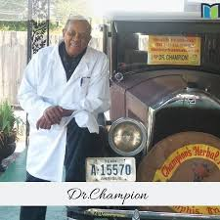
Dr. Champion also manages a successful mail-order herbal product business. He has received many prestigious awards including the 1987 Pharmacist of the Year Award. He has also been the topic of numerous articles and new
segments.

Slide 8
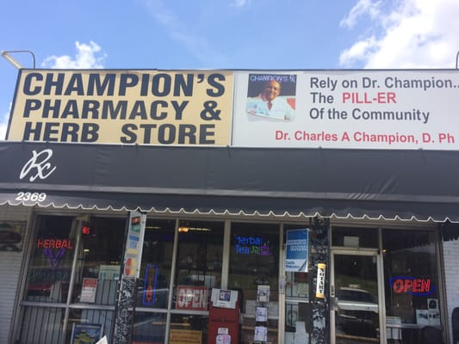
The Champion Mission
“We provide a holistic approach to living a healthier life.”

